Slide 1
AIDI 1010 - WEEK1 Introduction to Emerging Technologies Winter 2023
Jahanzeb Abbas (JB)

Slide 2
Course Objectives
Artificial Intelligence (AI) is a rapidly expanding and dynamic field with new applications and opportunities being discovered every day.
An AI/ML specialist must be able to identify the potential benefits of new technology, evaluate the feasibility of implementation and apply new technologies. Students will learn how to design and implement the latest Artificial Intelligence tools to solve these challenges.
Expand on the knowledge of machine learning frameworks by automating the evaluation process of a model and helping the framework select a model for us

Slide 3
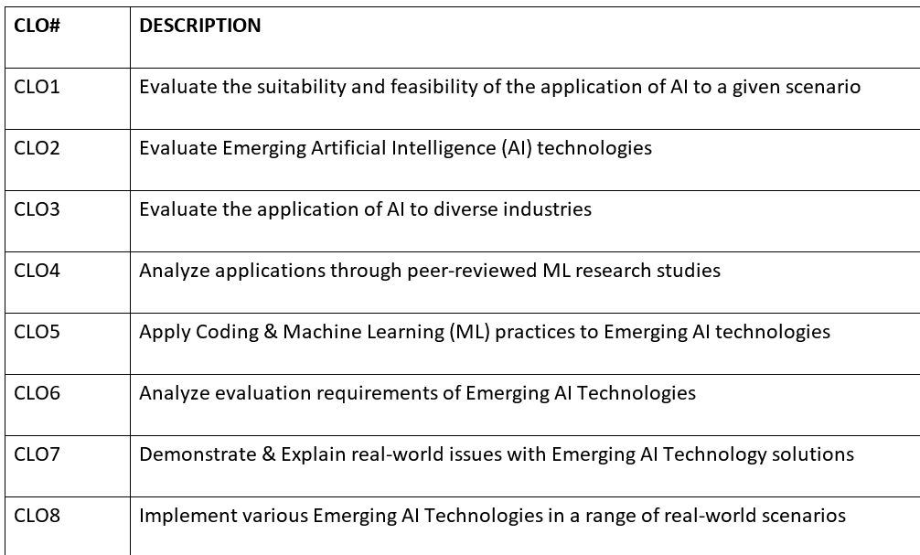
Course Learning Outcomes (CLO)
Students receiving a credit for this course will have reliably demonstrated their ability to:

Slide 4
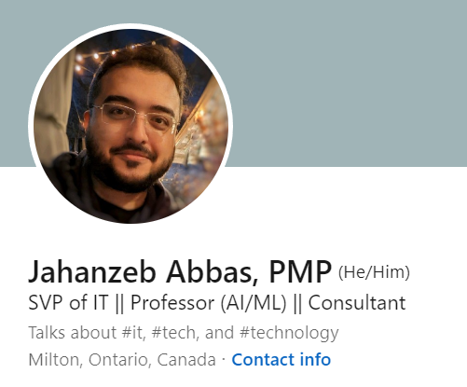
Instructor
https://www.linkedin.com/in/jahanzebabbas/

Slide 5
Instructor’s Contact Detail
You can reach me via email, response time within 48hrs:
Email: jahanzeb.abbas@georgiancollege.ca
Alternatively, you can message me directly on Microsoft Teams, response time will be 2x faster!

Slide 6
Instructor’s Expertise/Experience
Project Management & Delivery, Consultation
Project delivery, Issue management, consultation for different applications (CRM, SaaS)
Data Analytics & Modeling, ML Solutions
Descriptive, Predictive and Prescriptive Modeling
“Decision” Trees/Engines
Data Conversions, Cleansing, ETLs
Working with Structured & Unstructured datasets
Data cleansing, extract, transform, load functions
Instructor/Training Lead
Artificial intelligence and many enterprise related initiatives

Slide 7

Instructor’s Methodology
Principles
Instructor is a guide – students make their own path
Learning pathway will always be dual direction
Knowledge is power – sharing of power is key for extended learning
Respect & kindness
Sessions
Please follow syllabus (subject to changes)
Session Agendas
Course Learning Outcomes for the week, with “live” coding/sampling on Google Colab

Slide 8
Prerequisites
Skills
Ability and patience to read and write code in Python
Able to research, credit, and find concepts using Google/YT/Peer-Reviewed Paperwork
Able to share & present ideas to peers
Helpful:
Experience with any Programming Language
Knowledge on Machine Learning concepts
Tell me where you stand by filling out the Pre-Course-Survey
This is important to understand the scope of “industries” for group-shares

Slide 9

Expectations from Students
Expectations from Students
Believe and be confident that you will be leading AI efforts elsewhere in the future
Empower each other if any of you are struggling
Retain previous session details
Ask questions of any kind, no question is “stupid”
Show respect to everyone & be kind (including to the prof!)
Communicate any delays or late submissions in advance!

Slide 10
Textbook
None

Slide 11
Evaluation Details
Group Assignments 70%
20% – Assignment 1 (“Group Topic & Problem Statement”)
Details to be shared WEEK 3; Due on WEEK 5
20% – Assignment 2 (“Group Share, Prototype Presentation”)
Details to be shared WEEK3; Due weekly (per group) starting from WEEK9
30% – Project (“Group Share, Implementation”)
Details to be shared WEEK3; Due on WEEK 14
Test 30%
15% – Mid-Term Exam (Multiple Choice, Multi-Answers)
Evaluation on WEEK 7
15% – End-Term Exam (Multiple Choice, Multi-Answers)
Evaluation on WEEK 13

Slide 12
Submission/Marking of Assignments
Assignments will be due as prescribed on the Course Syllabus
Late assignments will be treated as follows:
Tests/examinations/assignments must be written/submitted at the time specified.
Requests for adjustments to that schedule must be made before the test/exam/assignment date to the faculty member. Failure to do so will result in a mark of “0”, unless an illness/emergency can be proven with appropriate documentation at no cost to the College.
Default extension of 24-hr late is admitted
The assignments will be marked and returned to the students two weeks after the due date

Slide 13
Submission/Marking of Assignments
All assignments and submitted documentation must be cited following APA formatting. All assignment rubrics must be followed carefully.

Slide 14
Thanks!
Any Questions?

